Slide 1
Class 1 - Foundational Chromebook Basics
Notes:
Welcome - Introduce the presenter(s) and the tech support personnel in the room.
Congratulations this is the first class or parents to attend the Parent Digital Citizenship Academy.
When you leave today you will be qualified to help other parents with simple technology needs. We also hope you will be our ambassadors for future technology trainings where we will offer more detailed training at your school.
Completing the training will also qualify you to receive a certificate of completion, Chromebook, hotspot- a portable wireless connector (if you need it), and mouse. These items will be given to you at the school site that sponsored you today.

Slide 2
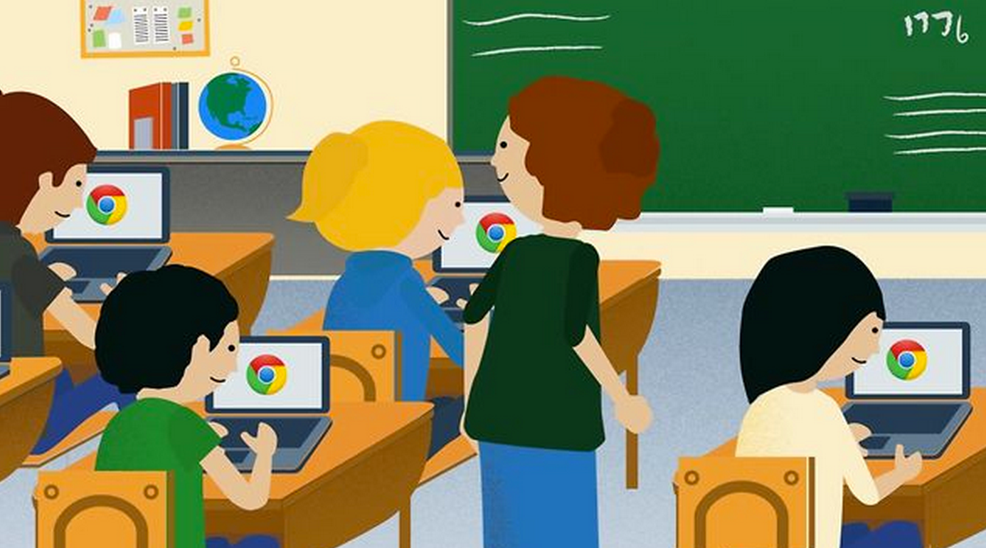
Learning about your Chromebook
Notes:
slides 2-9 about 10 minutes
We have been implementing chromebooks in our schools to provide technology access for students -
---How many of you have children who are using chromebooks or ipads in school?
Respond according the responses you receive.
We have a district wide Access for All. Grades 5th - 9th, next year Grades 4th - 10th.

Slide 3
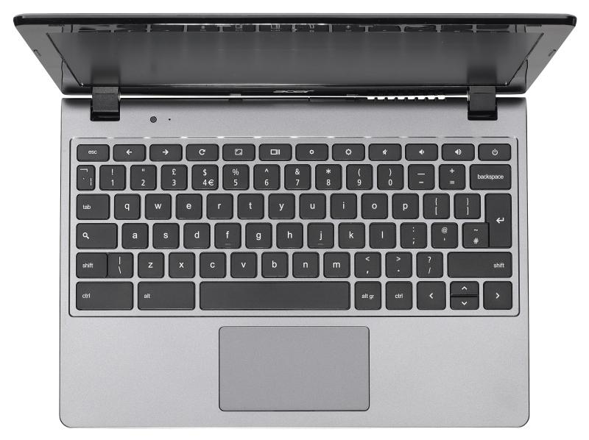
The Chromebook
The Chromebook looks and feels slightly different from a laptop or tablet.
Notes:
Let’s start with the basics - to get familiar with the chromebook - look at the next few slides and then we will practice.

Slide 4
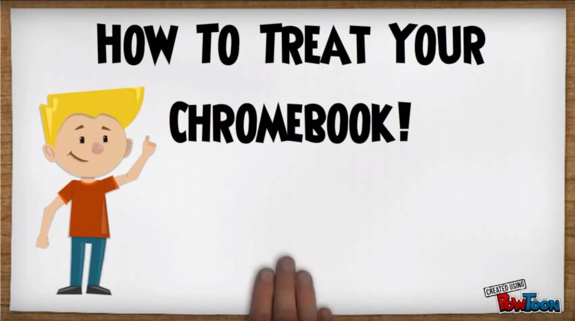
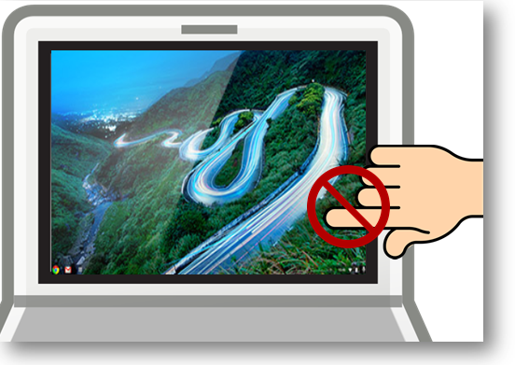
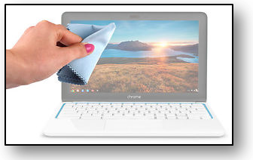
Chromebook General Care
How To Treat Your Chromebook!
Do not allow food or drinks near the Chromebook.
Do not touch the Chromebook screen. Clean the keys and screen with a lightly moistened (water only) soft cloth.
video- http://goo.gl/bAoxAd
Notes:
Play the video by clicking on “How to Treat Your Chromebook! is a hyperlink to a video (1:29 minutes)
tips for general care of your chromebook…”

Slide 5
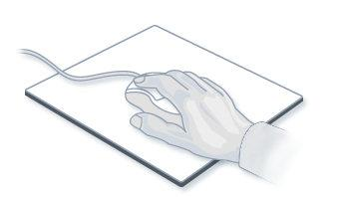
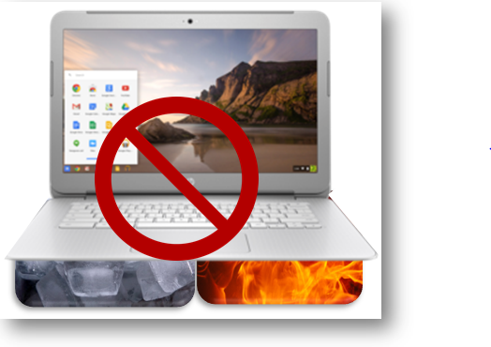
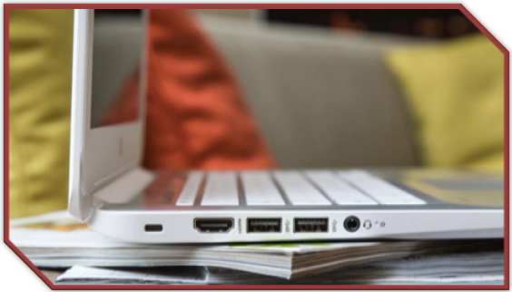
Chromebook General Care
Make sure your mouse is resting on a flat surface clear of obstacles. Is the mouse pad necessary?
Chromebooks do not like excessive heat or cold.
Do not place your Chromebook on uneven surfaces

Slide 6
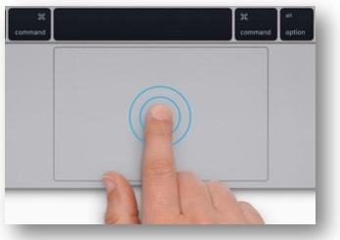
Moving Around on the Chromebook
or touchpad
mouse
Notes:
When you move the cursor over a link it will likely change from an arrow to a hand. (But not always!)

Slide 7
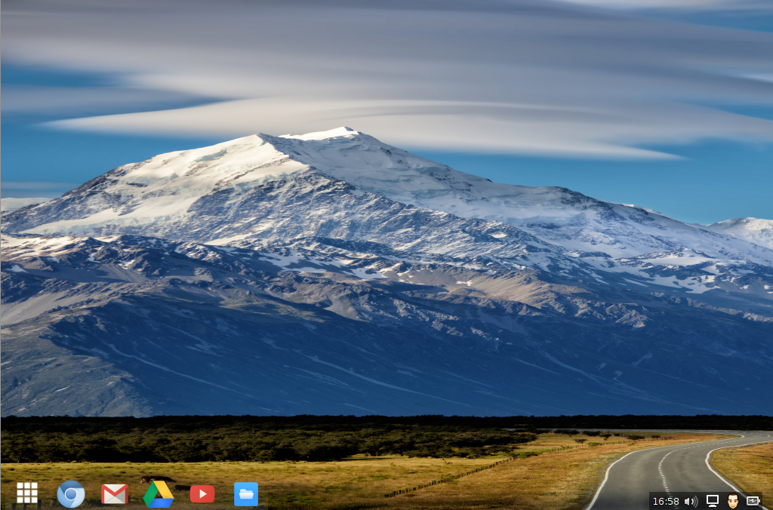
Arrow or Hand
The mouse or touchpad controls the cursor which you see as either an arrow you move around the page or a hand to select an option and/or link.
Notes:
The cursor will look like an arrow as it is moved around the screen.
When there is an active link the arrow turns to a hand.

Slide 8
Your Chromebook Keyboard
Refresh key --top row of the keyboard
Brightness controls --top row of the keyboard
Sound keys --top row of the keyboard
No caps lock
No Delete key -- use backspace instead
On/Off
Refresh key
Dim the screen
Make the screen brighter
Mute
Lower the volume
Raise the volume
Search Key
backspace
spacebar
Notes:
Have parents open the Chromebook and look at the keys while reviewing.
Top Keys
Left Arrow - Go to the previous page in your browser history
Reight Arrow - Go to the next page in your browser history
Circle Arrow - Reload your current page
Square w/out pointers - Hide the tabs and launcher in full-screen Immersive mode
Square and two lines - Show all windows in Overview mode
Small circle - Dim the screen
Larger circle - Make the screen brighter
Volume X - Mute
Volume --Lower the volume
Volume +Raise the volume

Slide 9
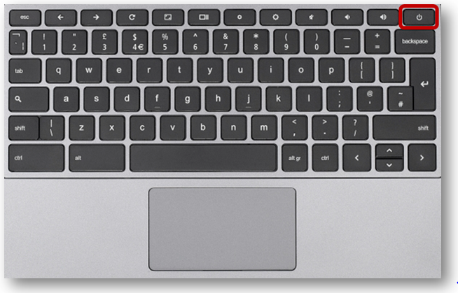
Turning the Chromebook on & off
The on/off button is on the keyboard. Usually the top right
To turn on your Chromebook press the power button for about four seconds. The screen will power on.
To turn off your Chromebook press the power button for about four seconds. The screen will go dark.
Or simply close the lid for sleep mode.
Notes:
Let’s start with the basics - to get familiar with the chromebook - lets look at the next few slides and then we will practice.
Recommend turn off.

Slide 10
Working with Google Applications
Notes:
slides 10-15 - 15 minutes Google applications or apps are free programs that you can use once you have established a google account. These programs can be used on your chromebook, a computer, or your smartphone.

Slide 11
What is a Google Account and
why do I need one?
Allows use of free Google applications - examples below
Google Drive for storage
Free Google “apps” to create documents, spreadsheets, and presentations
Separate gmail (email) account for school-related activities
Experience the Google apps your children are using at school.
*Click on the below link for directions on
How to create a Google Account
Notes:
Google Account creations will be done by the parents on their own time,

Slide 12
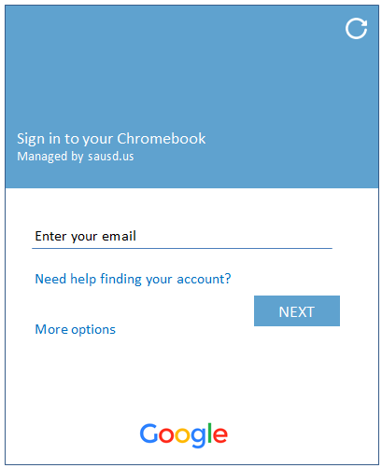
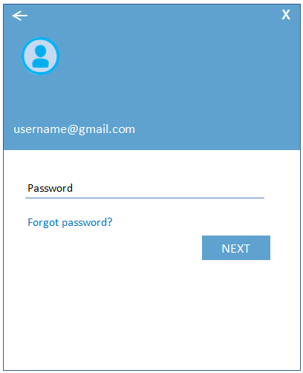
Log into the Chromebook
using the test account provided
Enter your Gmail username & Password provided on your handout.
Enter Gmail Username
& select Next
Enter Password
& select Next
Enter your Gmail
Username Only
Enter your Password
Notes:
Here is where we will have parents turn on the chromebook and now login. This screen is only for the day of the Digital Citizenship Academy. Parents will log in using the test student accounts provided.

Slide 13
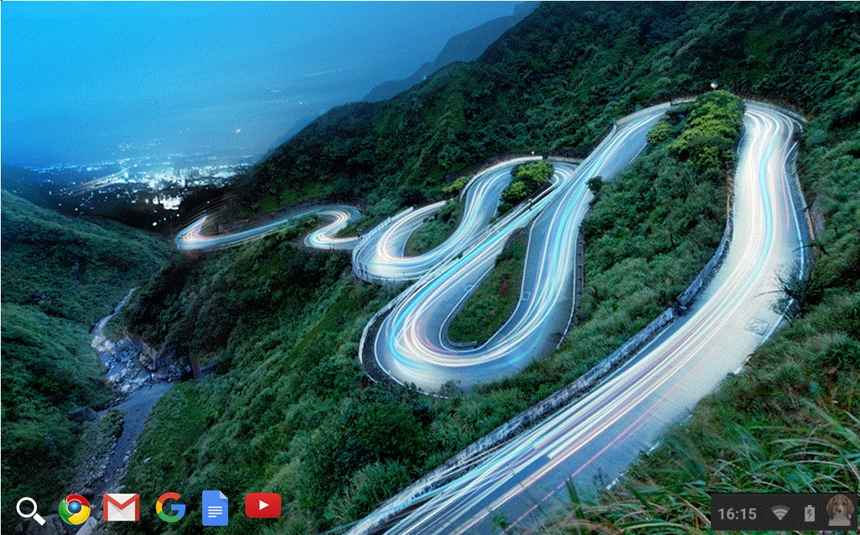
Screen After Logging In
Hold your mouse cursor over each of the icons above to identify where they lead - don’t click!
Notes:
Have the users hover mouse cursor over Google Chrome, Gmail, Google Docs, Youtube – don’t click!
Have users go back to Google and click

Slide 14
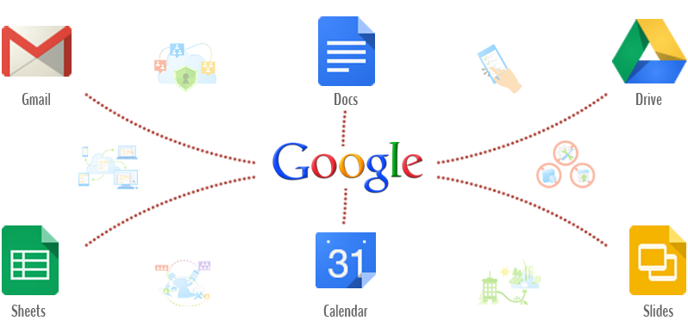
Google Apps
Notes:
What could we do with these apps?

Slide 15
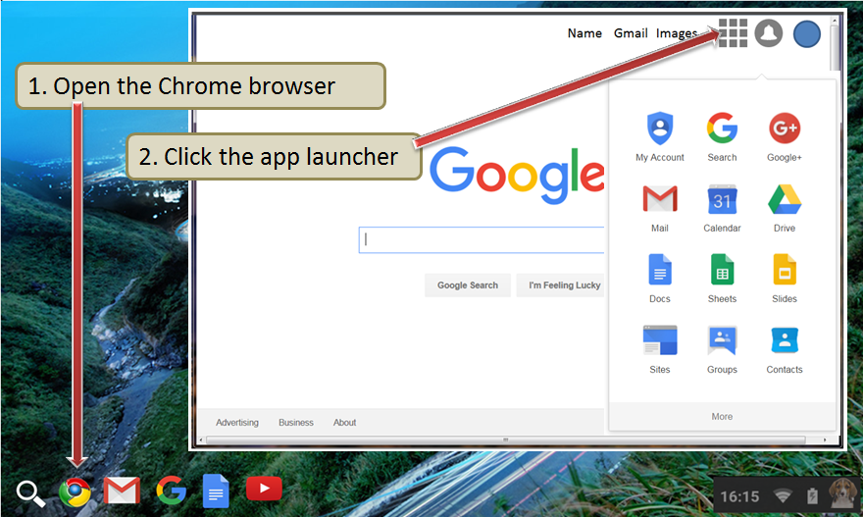
Google Apps Launcher
Notes:
Briefly talk about apps –have the users click on the Google icon and then click on apps icon in the top right corner. Emphasize Gmail, Drive, Translate, Calendar, maps.
These are the apps that your children are using in the classroom.
Click on gmail icon

Slide 16
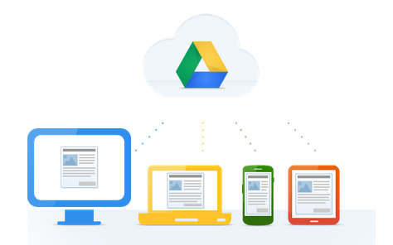
What is Google Drive?
Click on the link below to watch a video.
Google Drive: One Safe Place for all your stuff (English video)
Video Overview - Click to watch
Google Drive: Un lugar para todos tus documentos (en Español)
Haga un clic aquí para ver el video
Notes:
They can click on the English or Spanish video link that explains Google Drive. (video is 1:05 minutes))

Slide 17
Popular Apps in Google Drive
What is Google Drive?
A place to store, create, view and share your documents.
What is Google Docs?
Create letters, resumes, essays, etc. in Google Docs.
What is Google Sheets?
Create budgets, invoices, schedules, or track your expenses
using Google Sheets as a few examples.
What are the benefits of using these apps?
Google Docs and Sheets already have sample templates
created to help you get started.
Everything you do in these apps is automatically saved.
There are even more apps!

Slide 18
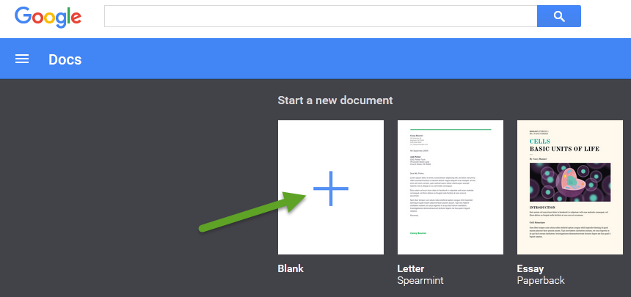
Google Docs
Click on the blank document to start a new one.
Notes:
Users can either click on the blank document or scroll through the sample documents provided.

Slide 19
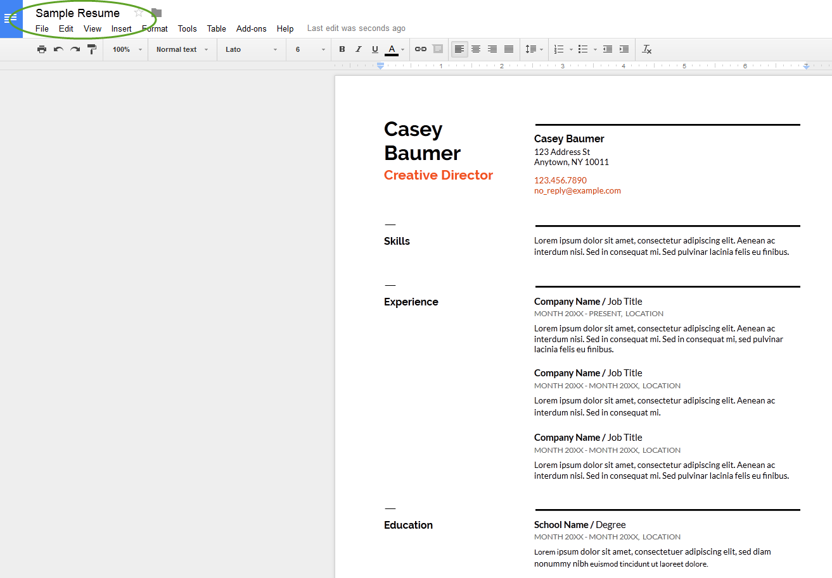
Google Docs
Use Google Docs to write a letter, create a resume, type an essay, etc.
Below is a sample resume created in Google Docs.

Slide 20
Google Sheets
Click in the blank sheet in order to start a new spreadsheet.

Slide 21
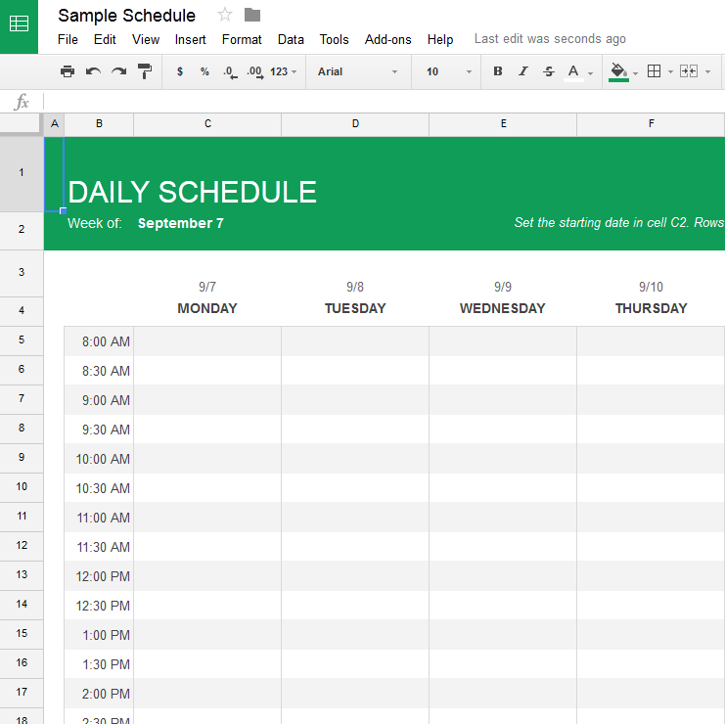
Google Sheets
Use Google Sheets in order to create a schedule, to-do list, budget, keep track of expenses, or create an invoice. Below is a sample of a schedule.

Slide 22
Working with Google Applications Gmail, a popular email
Notes:
slides 10-15 - 15 minutes Google applications or apps are free programs that you can use once you have established a google account. These programs can be used on your chromebook, a computer, or your smartphone.

Slide 23
What’s email and why use it?
Email is short for Electronic mail - a fast, easy, and inexpensive way to communicate with family, friends, and colleagues.
Email messages are sent from one person to another via a computer or mobile device such as a phone.
Email is more professional than a text - it is used in business.
The email message typically contains text, but can also contain files, images, or music
Notes:
Differences between email and texting Ask parents if they are using email now?

Slide 24
EMail Safety Tips
Always log off your email account and close the browser completely when using a public computer.
Don’t click on links in email unless you are certain of the url.
Don’t open files with the extension .exe, .zip, or .scr
Do not email anyone your bank account, social security number or credit card numbers
Remember not everything is true – hoaxes sent via email are very common.
Avoid Sweepstakes and Surveys.
Never buy from or reply to a Spam email.
Notes:
You will be getting directions for creating and using your email account, and we will be offering a class onXXXX

Slide 25
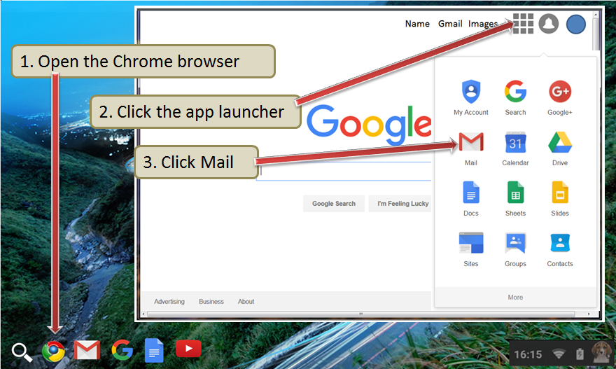
Google Gmail App
Notes:
Briefly talk about apps –have the users click on the Google icon and then click on apps icon in the top right corner. Emphasize Gmail, Drive, Translate, Calendar, maps.
Click on gmail icon

Slide 26
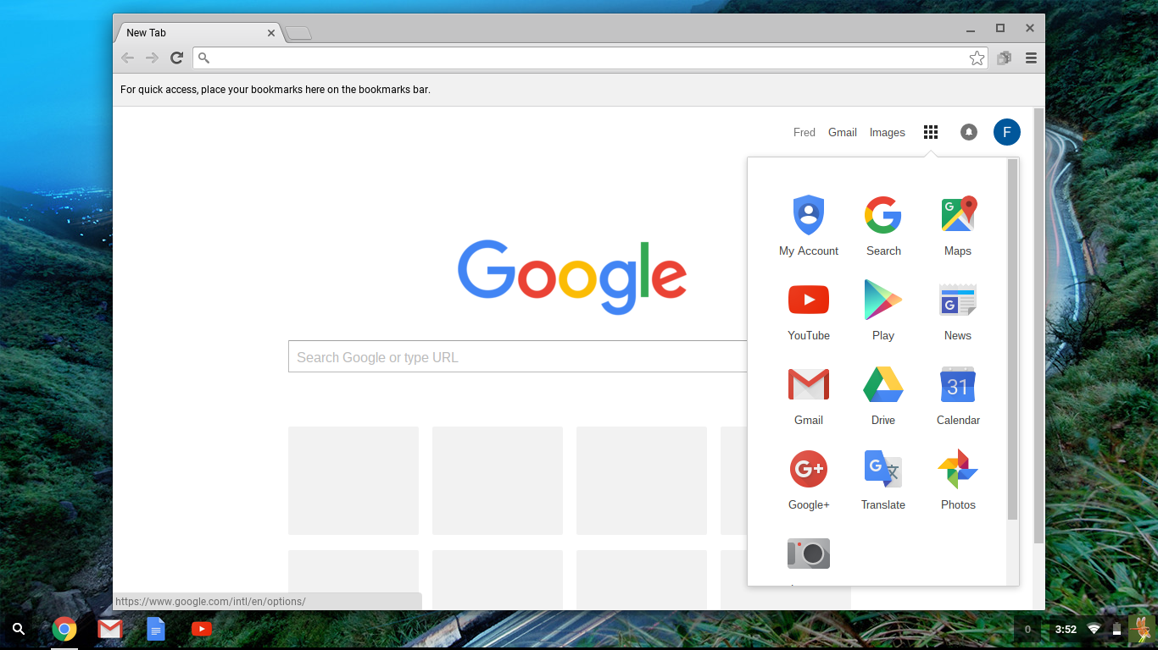
Using Google’s Gmail
*Click on the below link for more information on using Gmail
Email and Google Gmail
Notes:
slides 16- Click on gmail icon. Briefly talk about gmail, let them know that if they create a Google account, it will automatically create a gmail address for them too.

Slide 27
Connecting to the Internet

Slide 28
Connecting to the Internet -
What is a Wireless Network
SAUSD Chromebooks and iPads connect to the Internet using wireless network connections.
A wireless network is used to connect laptops, cell phones and other devices to the Internet.
If you have access to a wireless network at home you will be able to connect SAUSD Chromebooks and iPads.
Notes:
It works the same as your smartphone.
Wireless network uses radio waves to connect to laptops, cell phones, and other devices that are enabled to receive wireless signals to the Internet.
Be careful and don’t do online banking or shopping. Anyone could access your personal account information.

Slide 29
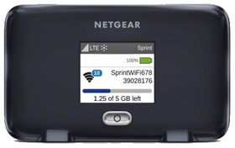
What is a Hotspot?
A hotspot allows you to connect wirelessly to Chromebooks and iPads. The hotspot has a network name and password that will need to be entered in the device in order for the hotspot to provide Internet access.
Get Started Hotspot PowerPoint
Video for Connecting Your Chromebook to WiFi
Notes:
Info is on the slide. Hotspots come with a user guide, your school site will also be able to help with hotspot setup.

Slide 30
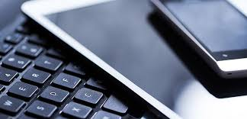
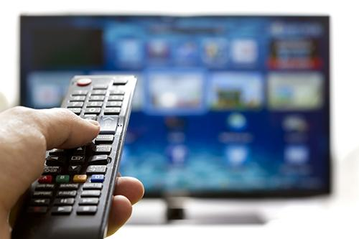
What do you use to connect to the Internet?
Notes:
Ask parents about their use of the internet. What do you use at home to connect to the Internet?

Slide 31
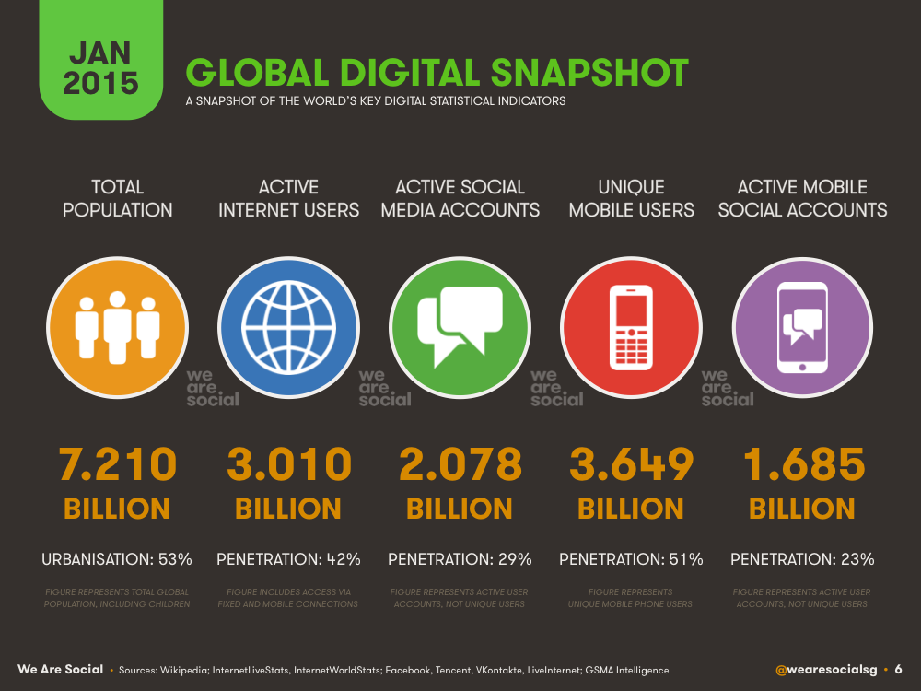
Notes:
we’re all on the internet!

Slide 32
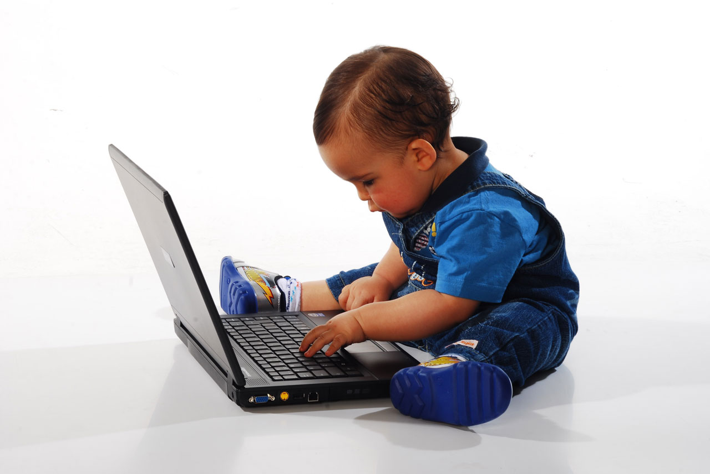
Notes:
...and so are your children!

Slide 33
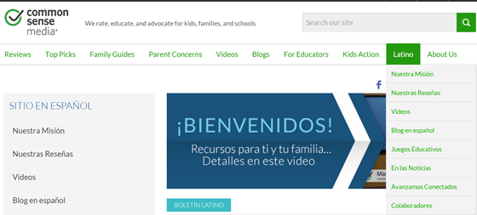
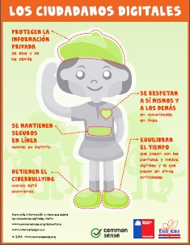
Parenting in the Online World
https://www.commonsensemedia.org/latino
¿Cómo usar la tecnología de forma segura y balanceada?
Notes:
Common Sense Media is a wonderful website with wonderful resources for parents in English and Spanish. The screen shot shows the landing page for the Latino section. Click on and show the video (3:03 minutes).

Slide 34
Break Time
Please turn off the Chromebook

Slide 35
Notes:
End of class 1. Ask if there are any questions or comments.

